Slide 1
Introduction to SystemRDL
Industry standard Register Description Language from Accellera

Slide 2
SystemRDL in a Nutshell
A language specifically designed for defining and managing registers in digital systems.
Supports registers of all types, including traditional configuration registers, register arrays, and memories.
SystemRDL is a language used for the design and delivery of intellectual property (IP) products.
Promotes automation of register model generation and verification processes, reducing errors and manual work.

Slide 3

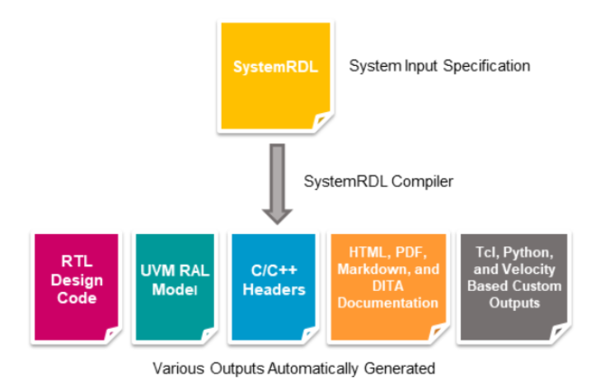
The Intent of SystemRDL
It reduces the development cycle for:
Hardware designers
Hardware verification engineers
Software developers
Documentation developers
Intended for:
RTL generation
RTL verification
SystemC generation
Documentation generation
Software development

Slide 4
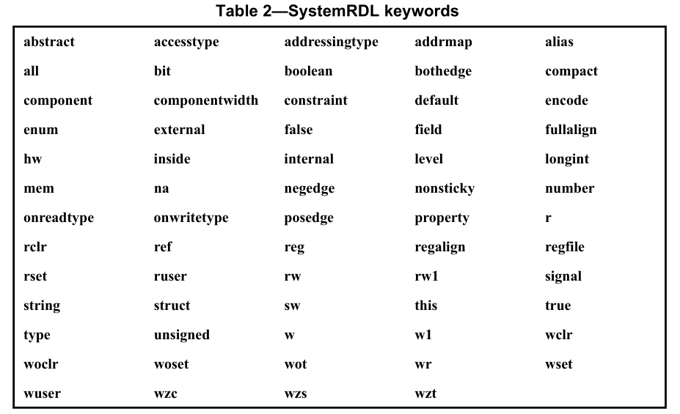
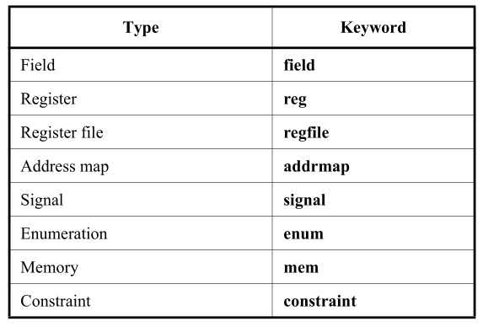
Defining components & Keywords
These components offer a structured, standardized way to describe the register and memory architecture of hardware devices.

Slide 5
SystemRDL Sample Code for a Single Register
addrmap example_reg {
reg {
// Define a field named "control" with read-write access for software and read access for hardware
field {
name = "control";
desc = "Control Field"; // Description of the field
sw = rw; // Software access type: read-write
hw = r; // Hardware access type: read only
reset = 0x0; // Reset value
} control[3:0];
} example_reg @0x0; // Register address
};

Slide 6
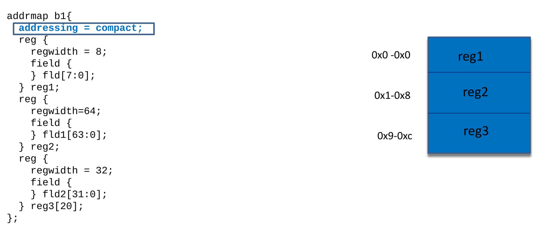
SystemRDL Addressing Modes
There are three addressing modes defined in SystemRDL: compact, regalign (the default), and fullalign. These addressing modes are set using the addressing address map property
(i)- Compact
It specifies the components are packed tightly together.

Slide 7
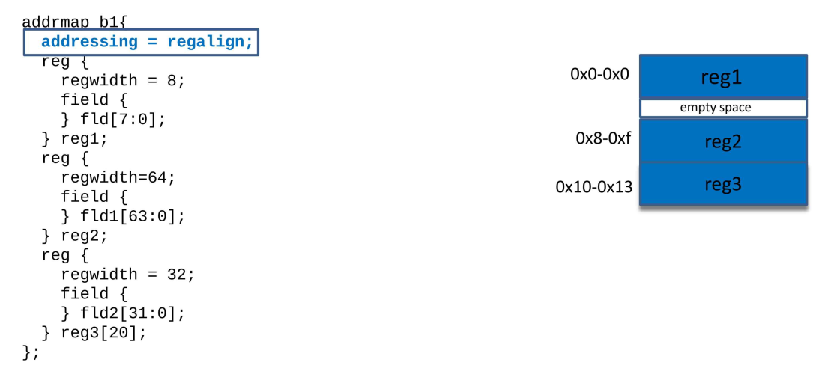
SystemRDL Addressing Modes
(ii)- Regalign(default)
It specifies the components are packed so each component’s start address is a multiple of its size.

Slide 8
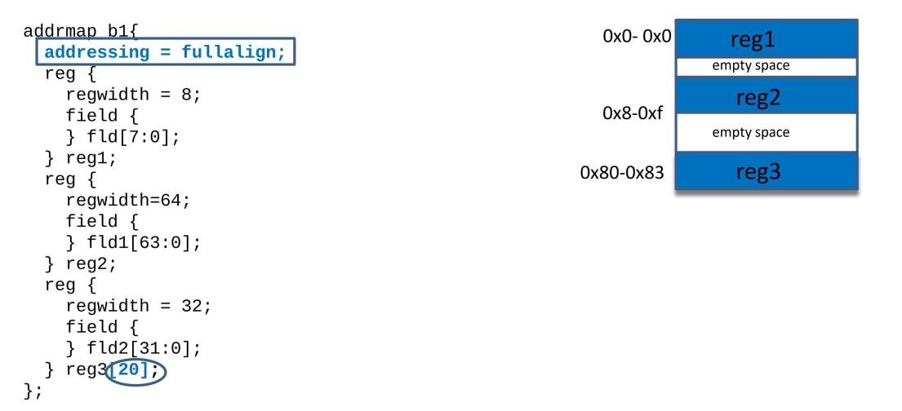
SystemRDL Addressing Modes
(iii)- Fullalign
The assigning of addresses is similar regalign, except for arrays.
The alignment value for the first element in an array is the size in bytes of the whole array (i.e., the size of an array
element multiplied by the number of elements), rounded up to nearest power of two.

Slide 9
Tools Required to Compile SystemRDL Code
PeakRDL: An open-source tool for compiling SystemRDL and generating register models and different views from single source.
  Provides command-line tool for various aspects of register automation.
  Processes SystemRDL 2.0 register descriptions.
  Generates synthesizable SystemVerilog RTL register blocks.
  Create rich and dynamic HTML documentation.
  Builds UVM register model abstraction layer.
  Generates C register abstraction headers for software.
  Supports IP-XACT: Import & export IP-XACT XML.
  Tool is extensible via plugins for additional functionality.

Slide 10
Installation Steps
Ensure proper installation of PeakRDL and related dependencies using command line and Python version Python 3.11.6 has been used.
Make a virtual environment named systemRDL and install the dependencies in that container.
python3 -m venv systemRDL
Once the virtual environment is created, you need to activate it.
source systemRDL/bin/activate
With the virtual environment active, install PeakRDL using pip or just download requirements.txt file and run pip command with providing requirements.txt file.
pip install peakrdl or pip install requirements.txt
Once the installation is complete, you can verify if peakrdl is installed by checking the version:
peakrdl --version
Run commands via terminal to compile SystemRDL files.

Slide 11
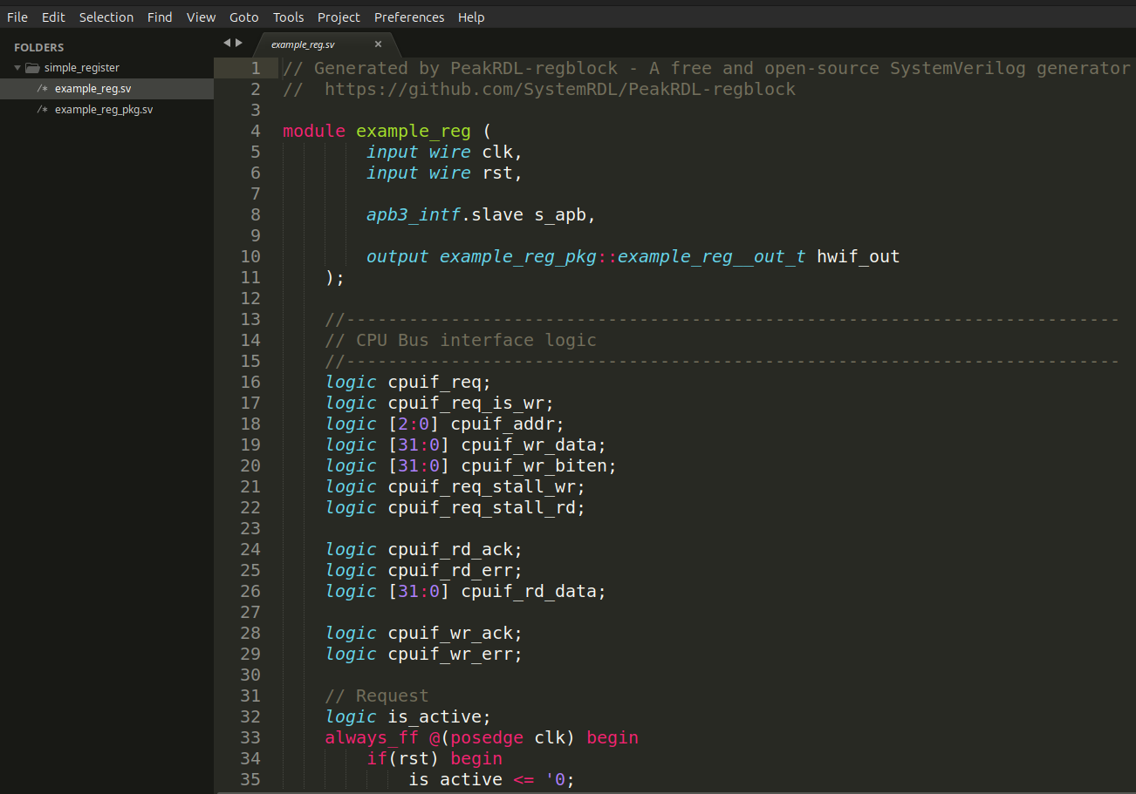
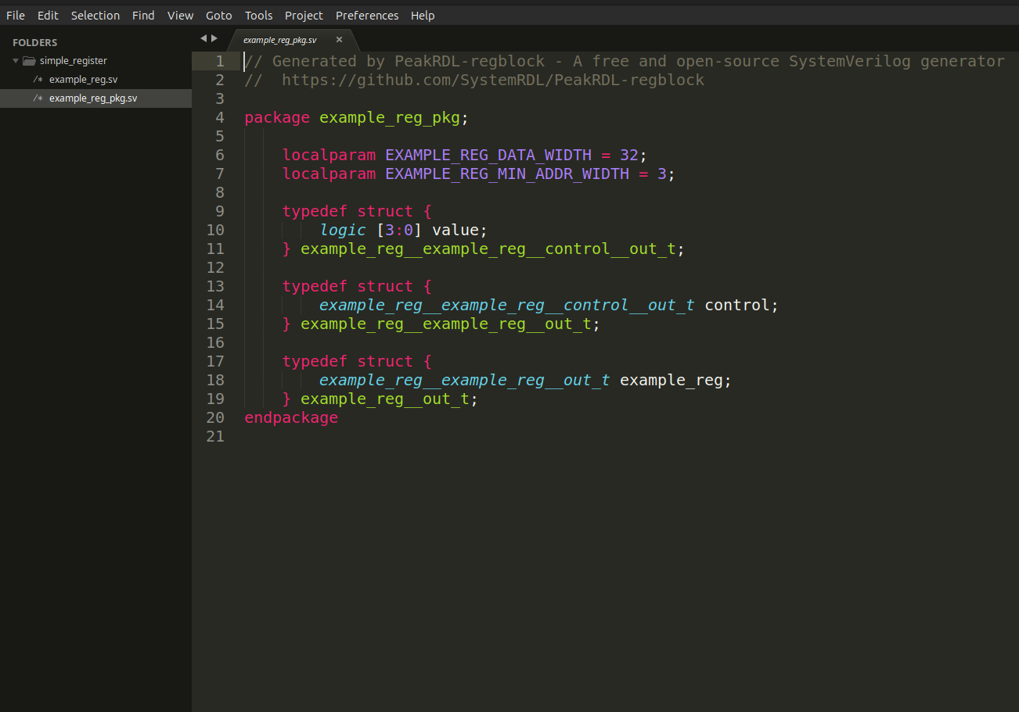
Compile SystemRDL to SystemVerilog
RTL Generation
compile the example_register.rdl file to generate RTL in SystemVerilog using PeakRDL and by default it will implement apb3 interface.
Command: peakrdl regblock simple_register.rdl -o simple_register

Slide 12
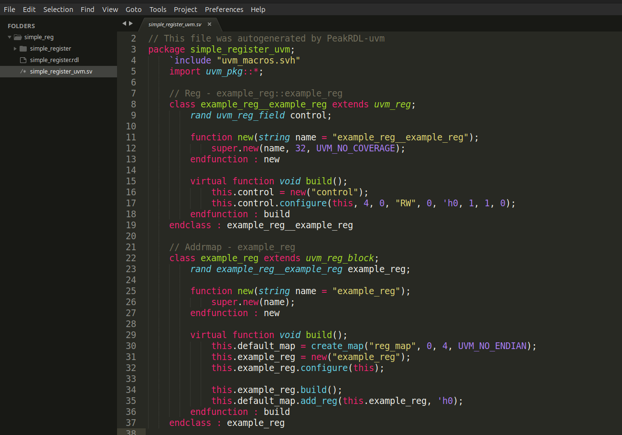
Register Model Generation (UVM)
UVM Generation
compile the example_register.rdl file to generate Register Model in SystemVerilog using PeakRDL.
Command:
peakrdl uvm simple_register.rdl -o simple_register.sv

Slide 13
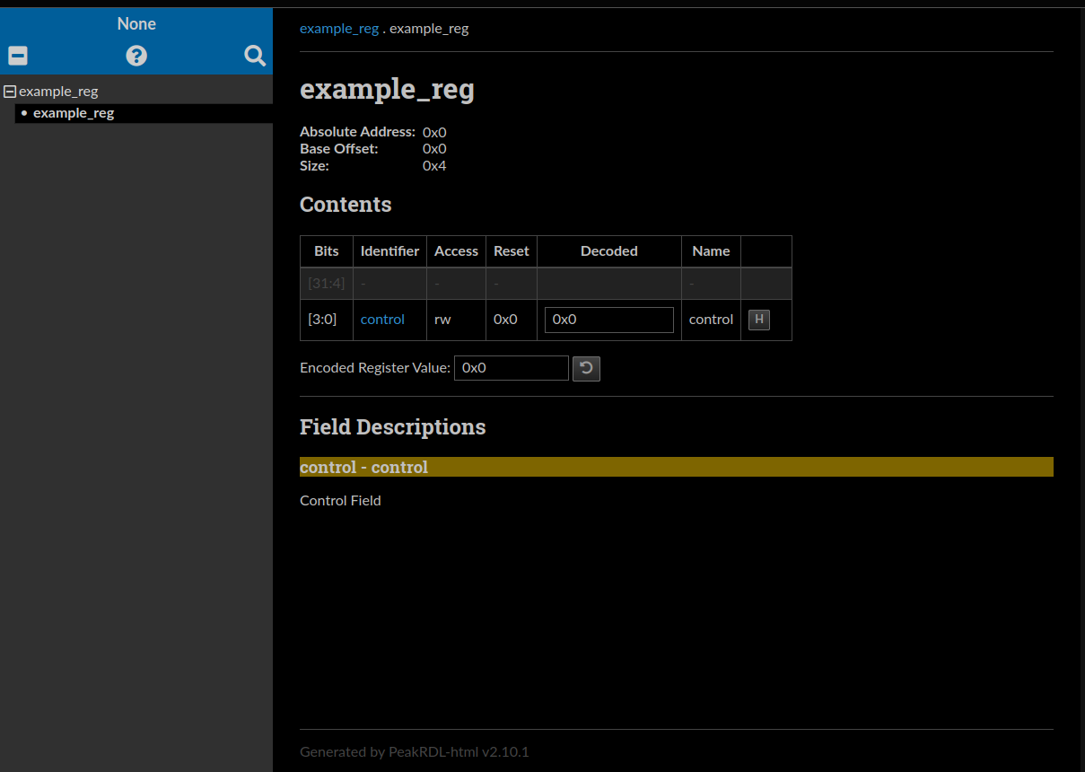
Documentation
HTML Documentation Generation
compile the example_register.rdl file to generate Register Model in SystemVerilog using PeakRDL.
Command:
peakrdl html simple_register.rdl -o documentation_html

Slide 14
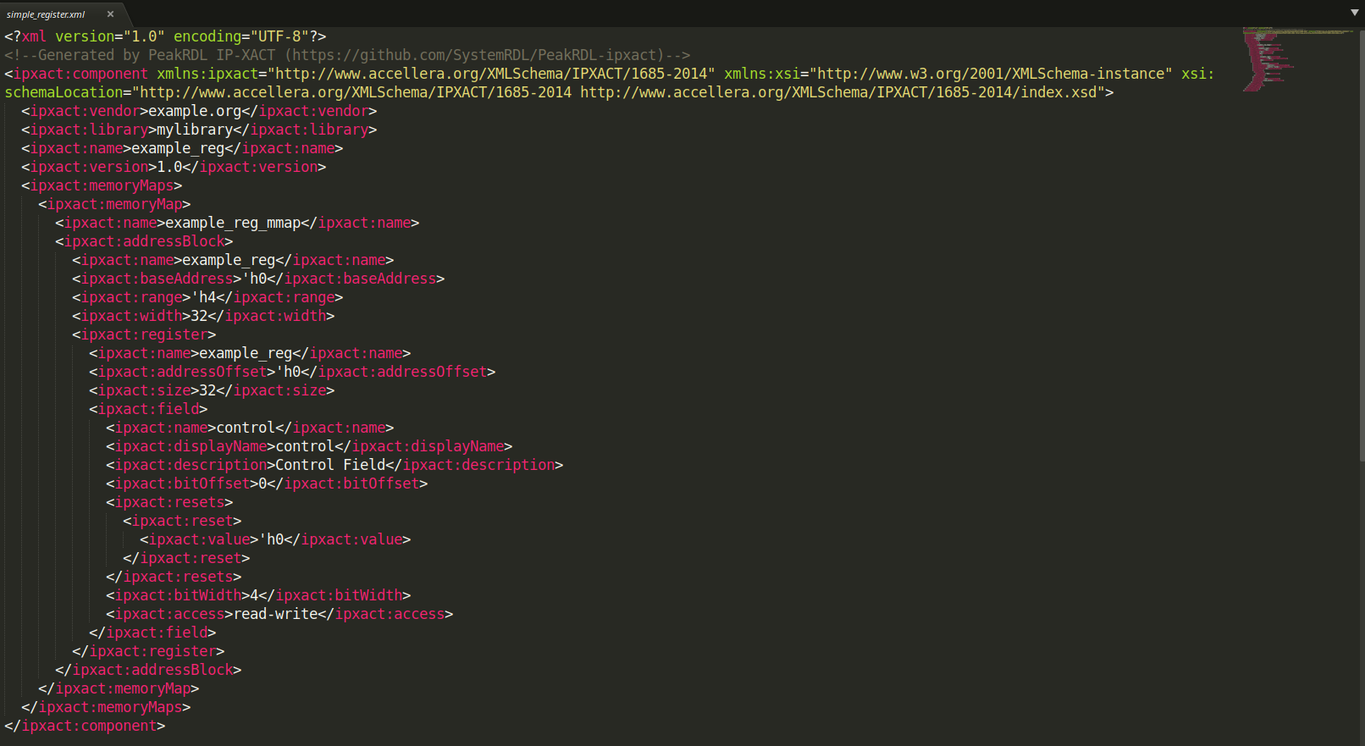
IP-XACT XML
XML Generation
compile the example_register.rdl file to generate IP-XACT XML file using PeakRDL.
Command:
peakrdl ip-xact simple_register.rdl -o simple_register.xml

Slide 15
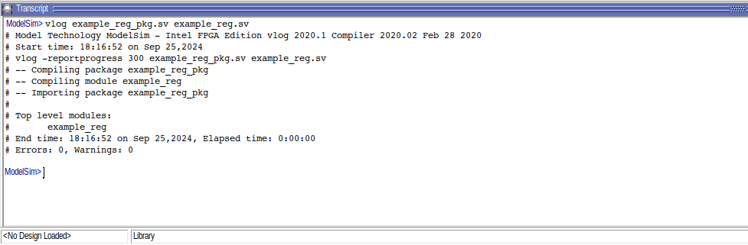

Compilation Result of Automated RTL
Command: ModelSim> vlog example_reg_pkg.sv example_reg.sv

Slide 16
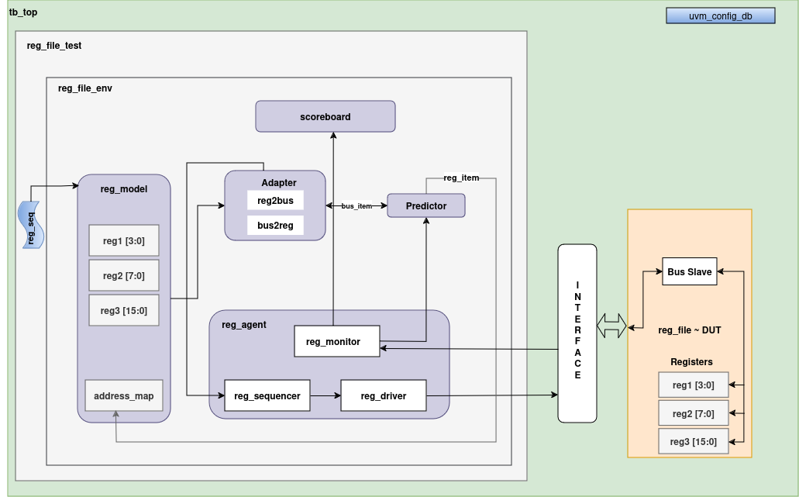
UVM Register Model Architecture with APB

Slide 17
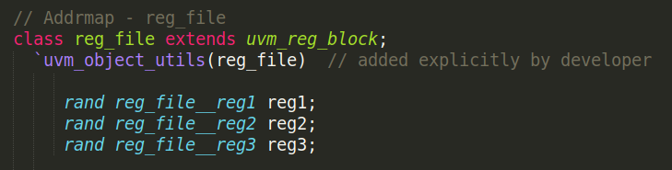
Integration of RTL and Register Model in UVM Environment
Challenges and Limitations:
  Default abp3 slave implemented in automated RTL code to interact with register file.
  It does not include a mechanism for wait states.
  In the code, PREADY is driven directly by cpuif_rd_ack | cpuif_wr_ack, meaning the transaction completes immediately once the register is accessed.
  I had observed an error from the automated register model where no data type was mentioned and I had to add an extra line to overcome the problem.

Slide 18
Integration of RTL and Register Model in UVM Environment
APB Master Implementation:
  Code has been written for APB master in uvm component Driver.
  It has followed the APB Spec to implement the sequence of signals to drive to the interface and then DUT(slave).
  Timeout logic has been implemented, where it waits for PREADY from the slave for defined number of cycles.
  If no PREADY signal receives from slave then it should timeout with throwing error and starts next transaction.
  If PREADY receives from slave within timeout counter cycles then it should complete the transaction and write/read from the slave.

Slide 19
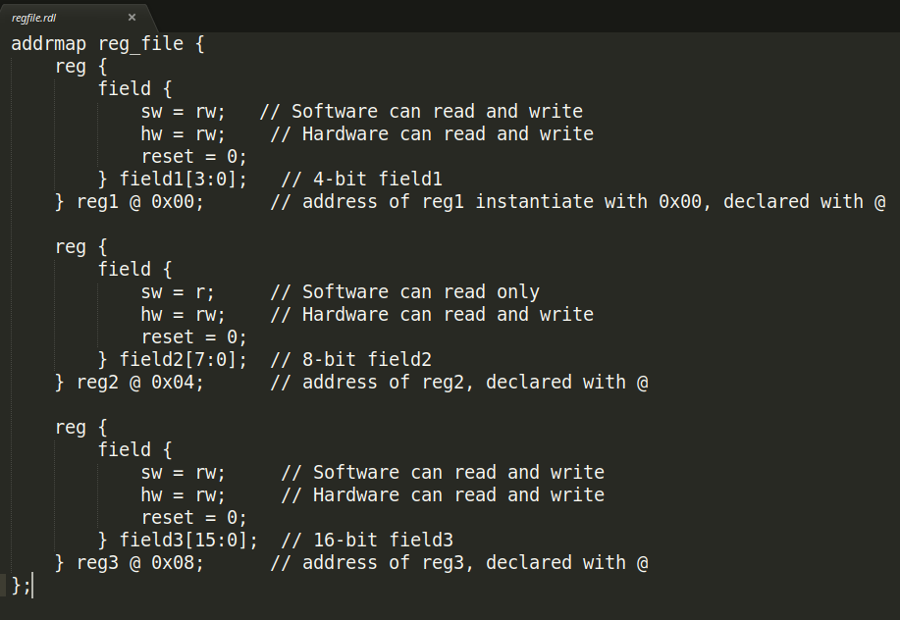
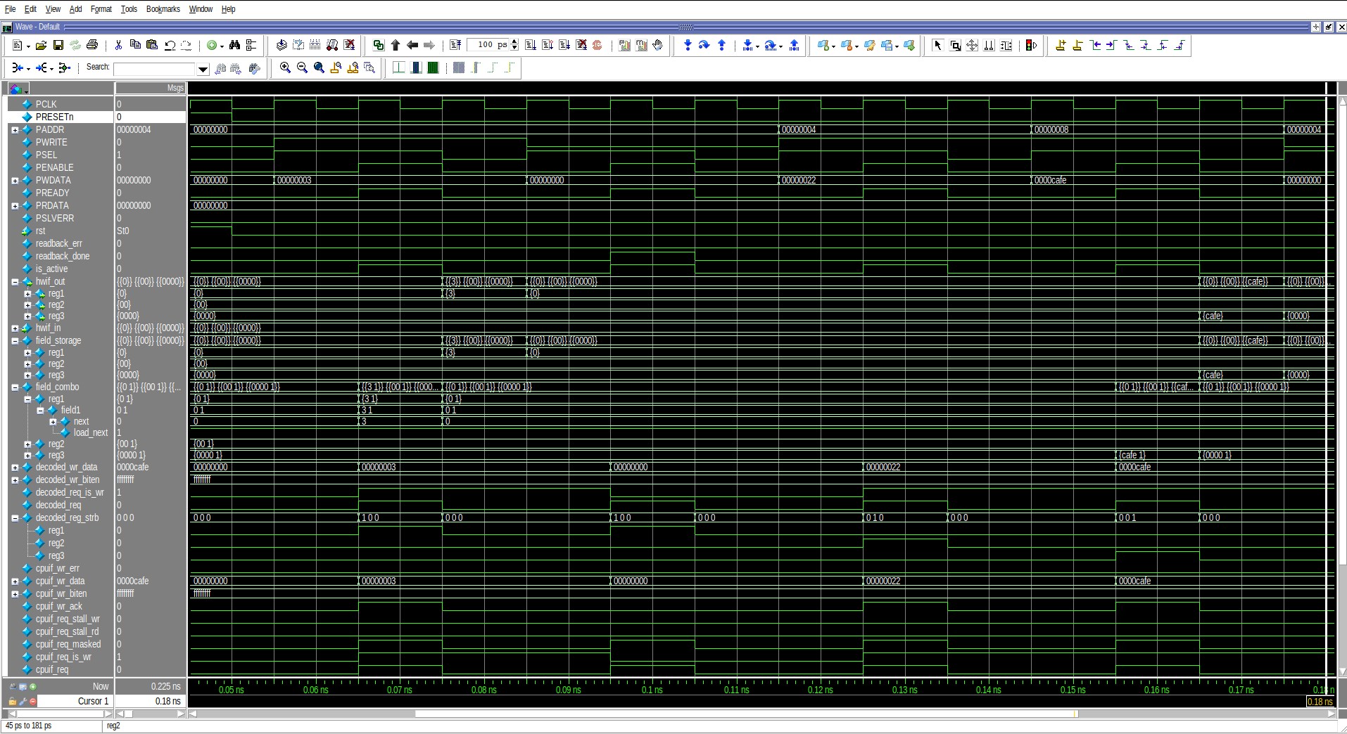
Integration of RTL and Register Model in UVM Environment
Challenges:
  When I write to some specific register by using register model API, the result reflects in RTL and stored successfully, after the next clock edge it writes zero to that specific register.
  I have given access type in register description ( hw = rw) and (sw = rw).

Slide 20
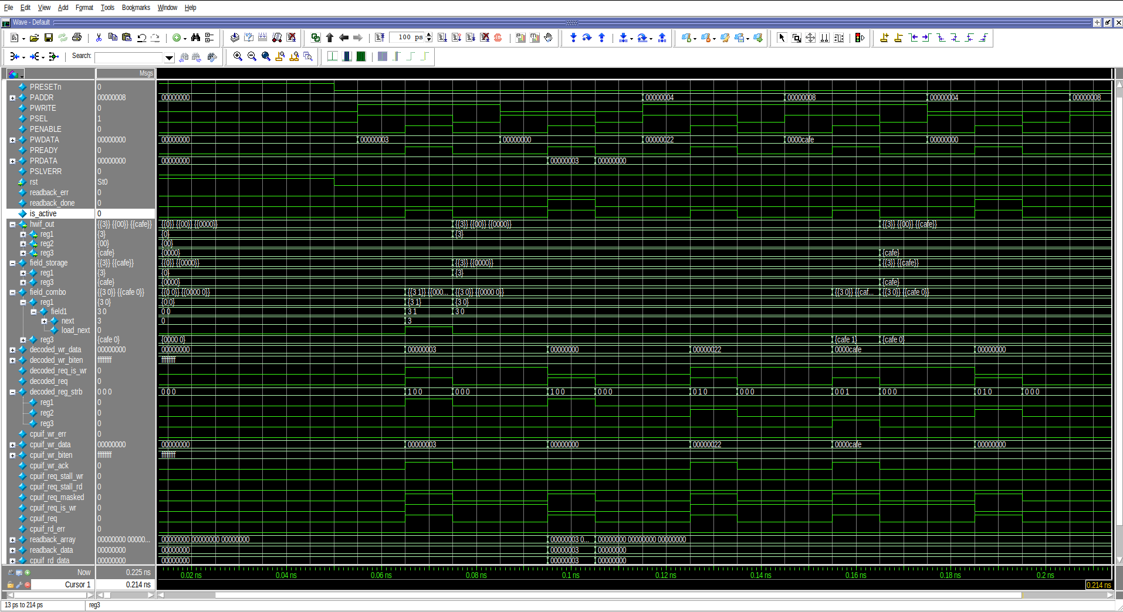
Integration of RTL and Register Model in UVM Environment
Solution:
  I realized that I had given an access type field in systemRDL code (hw = rw).
  Hardware interface over writes the register with zero.
  After changing the access type field to (hw = r) in systemRDL and generating RTL and register model again, the problem was solved, at least the RTL was not overwriting the registers.

Slide 21
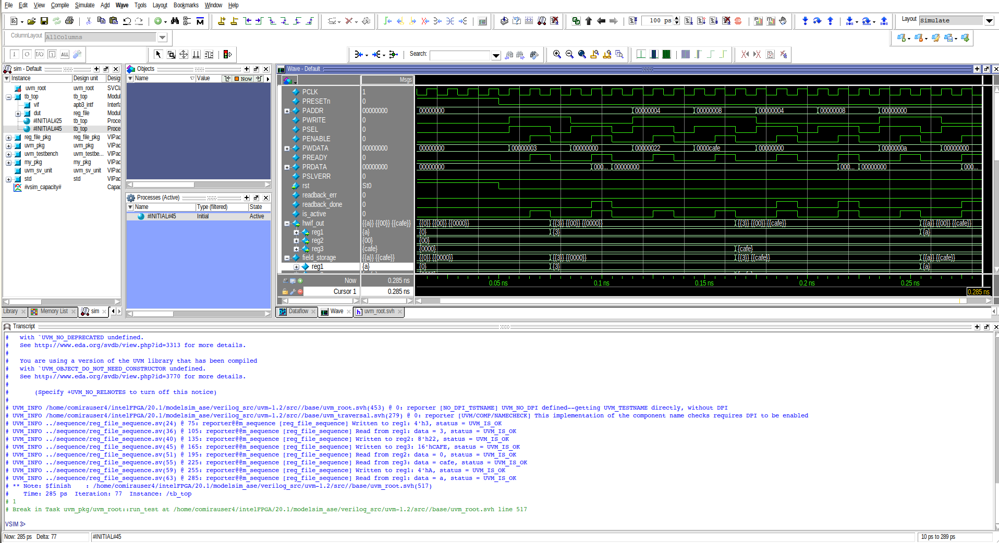
Waveform of APB Implementation with Automated slave

Slide 22
Integration of Custom APB slave with generated Register file
CPU Interfaces:
  When the command has been given to make a register file, then by default it selects apb3 interface and tied with register file.
  The CPU interface logic layer provides an abstraction between the application-specific bus protocol and the internal register file logic.
  If you want to generate register file then you have options to select from a variety of popular CPU interface protocols by just providing argument of the required protocol.
Command line:
peakrdl regblock -o ./output/ --cpuif <required_protocol> regfile.rdl
--cpuif apb3
--cpuif apb3-flat
--cpuif apb4
--cpuif axi4-lite
--cpuif axi4-lite-flat
--cpuif avalon-mm
--cpuif avalon-mm-flat
--cpuif passthrough

Slide 23
Integration of Custom APB slave with generated Register file
CPUIF Passthrough:
  This cpuif mode bypasses the protocol converter stage and directly exposes the internal cpuif handshake signals to the user.
  Export the regfile.rdl using the passthrough option.
  It is used to generate the output without following any CPU protocol, using the passthrough option.
Command line:
peakrdl regblock -o ./output/ --cpuif passthrough regfile.rdl

Slide 24
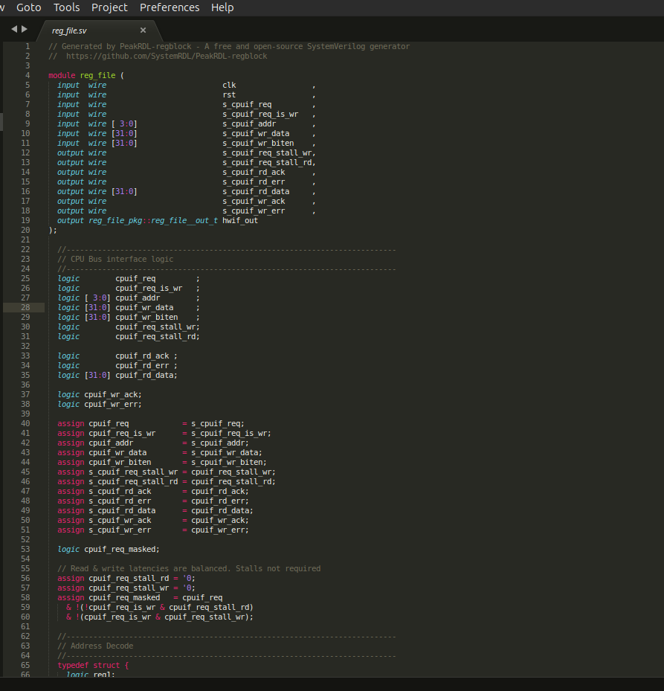
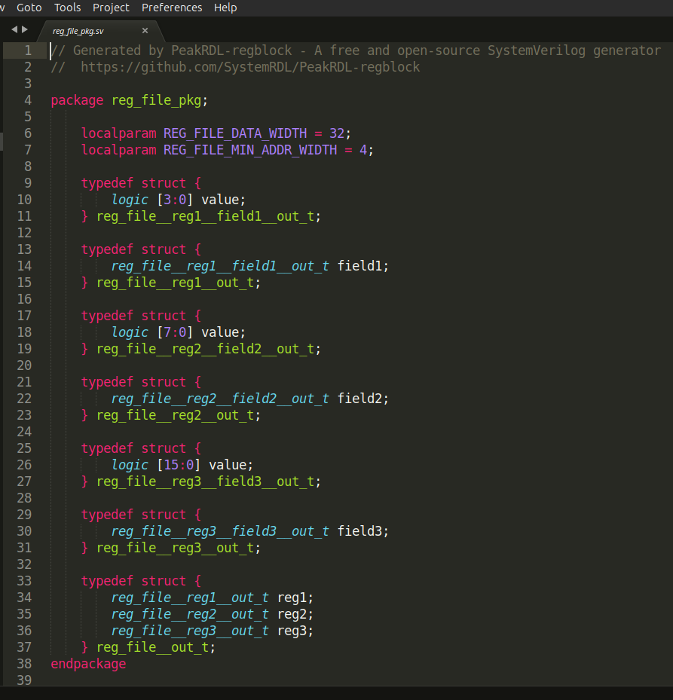
Integration of Custom APB slave with generated Register file
CPUIF Passthrough Output:

Slide 25
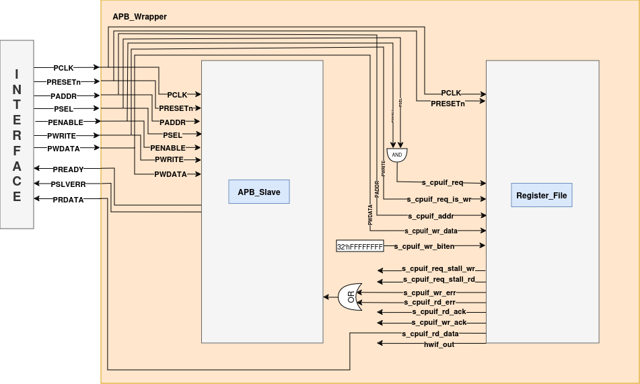
Integration of Custom APB slave with generated Register file

Slide 26
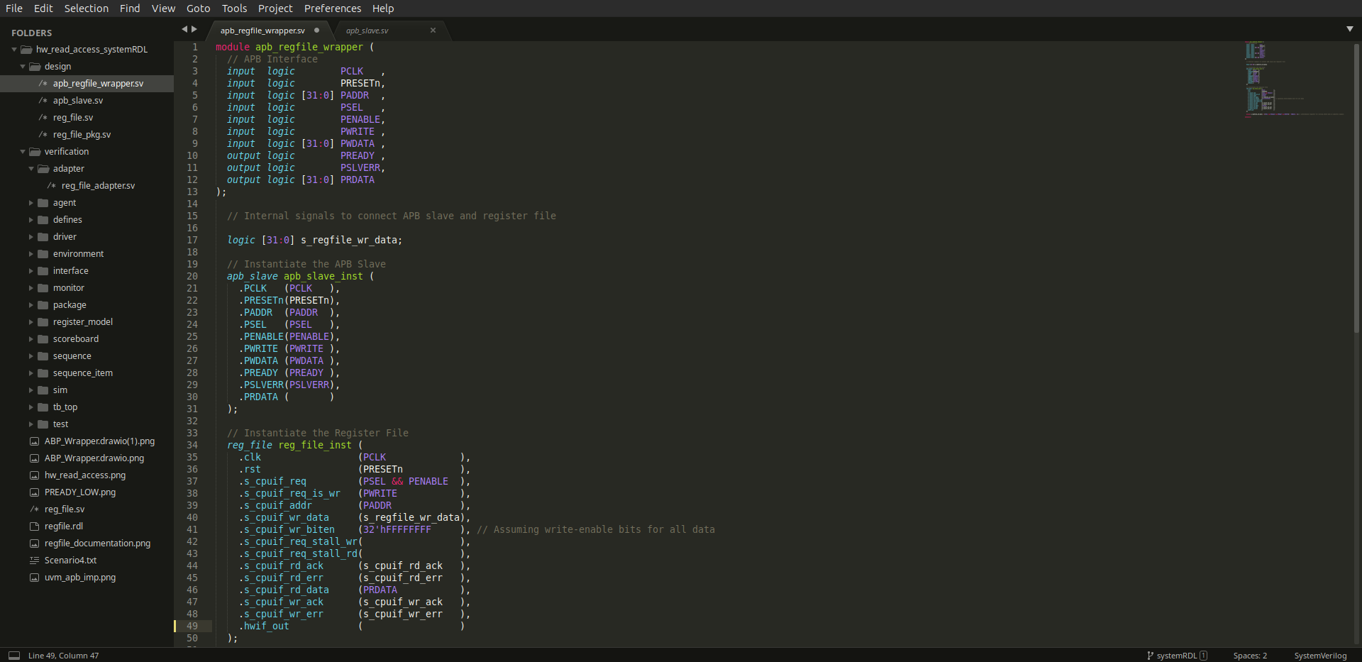
Integration of Custom APB slave with generated Register file

Slide 27
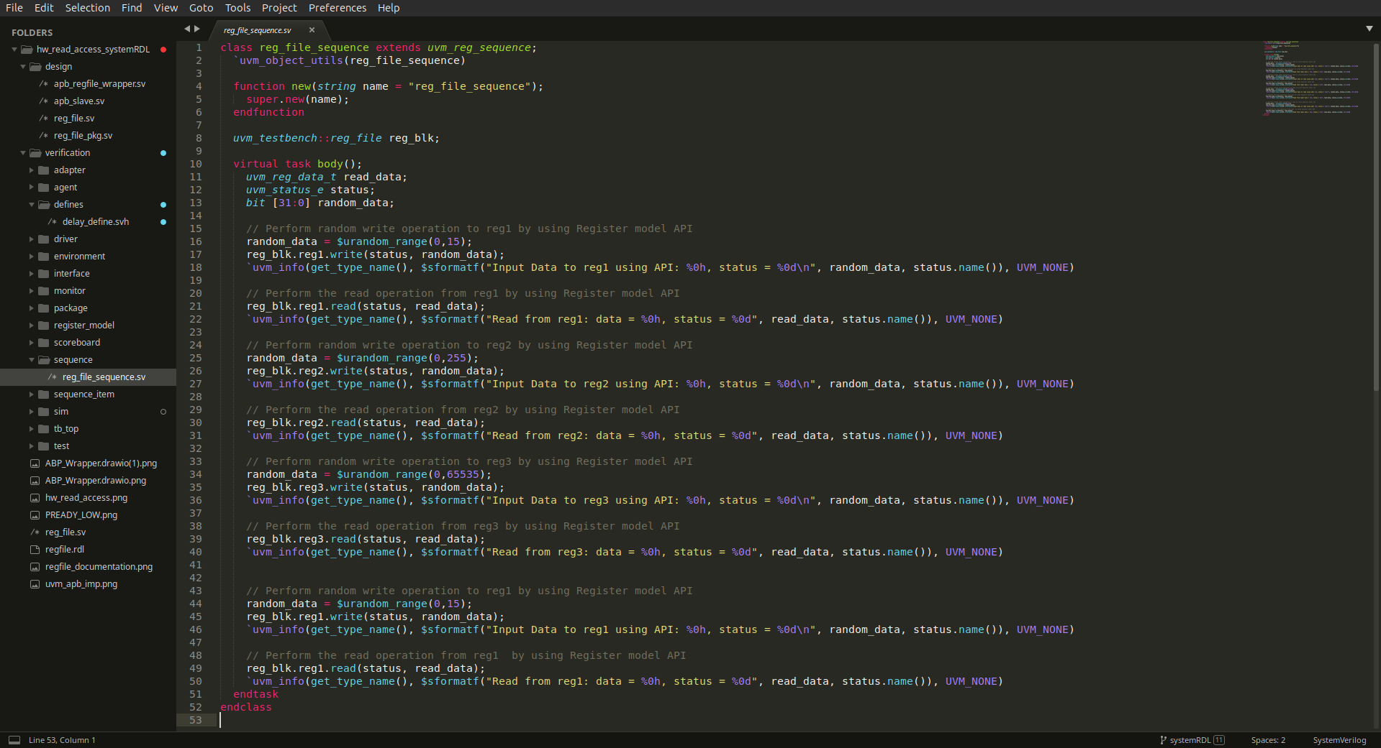
Sequence given by using register model API

Slide 28
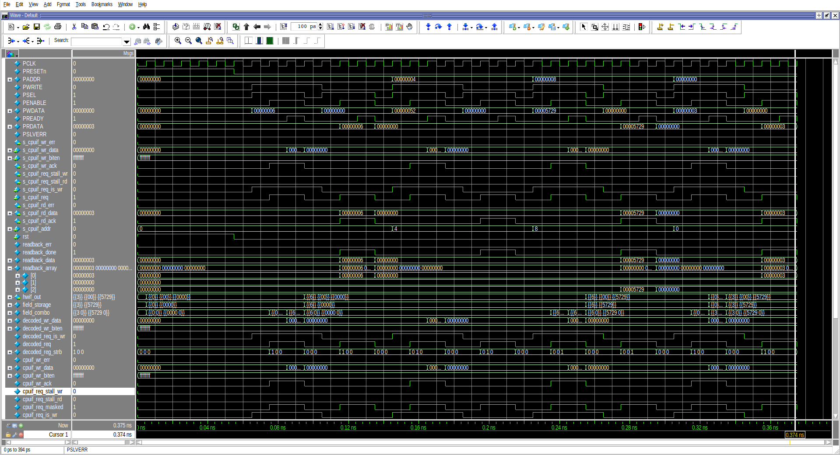
Integration of Custom APB slave with generated Register file

Slide 29
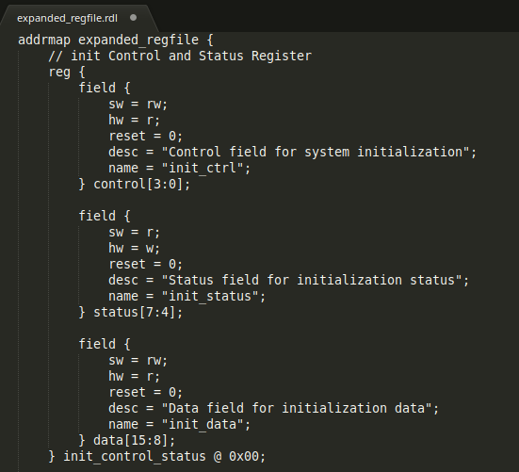
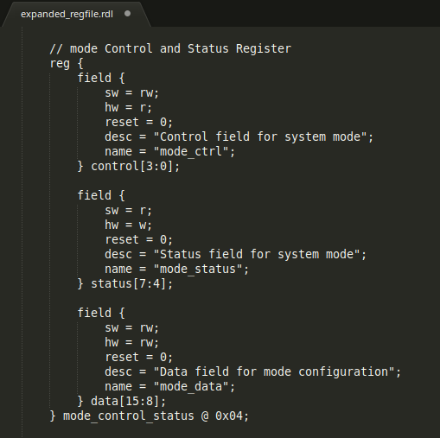
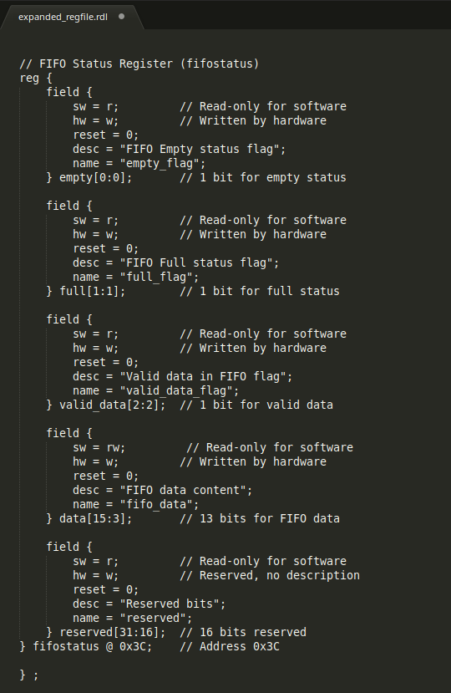
Extended Register File
Register Description:
  Written code for register description with sixteen registers in it.
  Every register has multiple and variable length of fields.
  Every field has different hardware and software access types.
  Register File has been created with using Passthrough argument to the PeakRDL command.

Slide 30
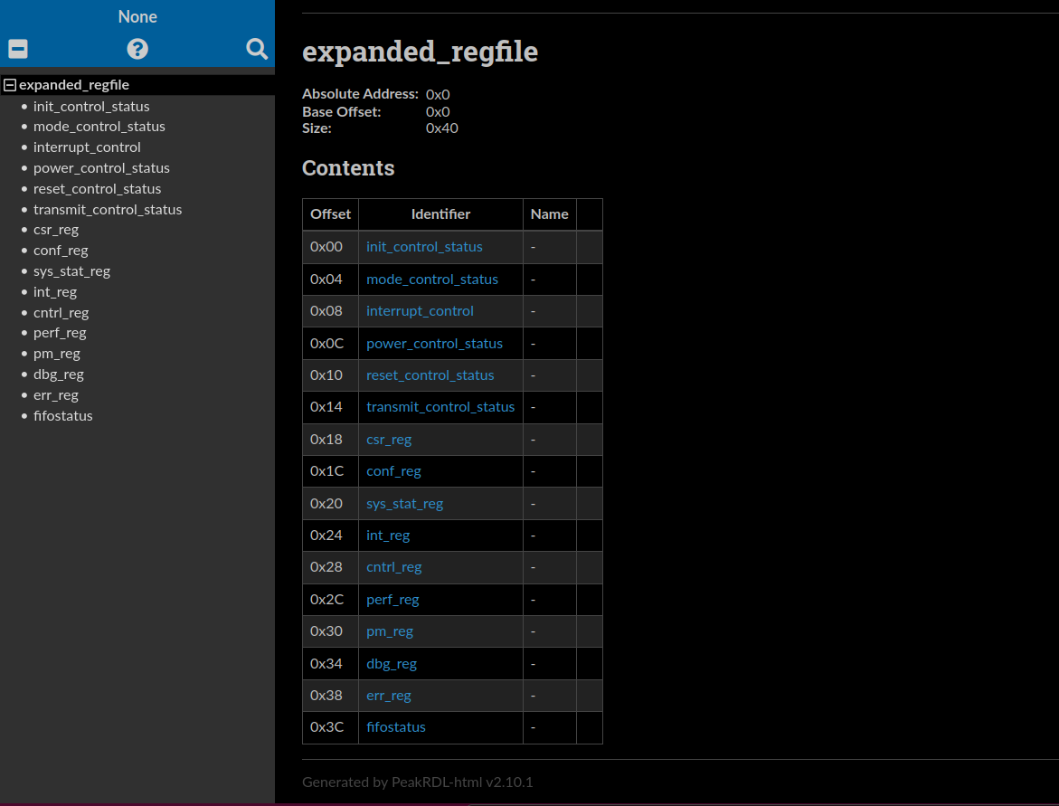
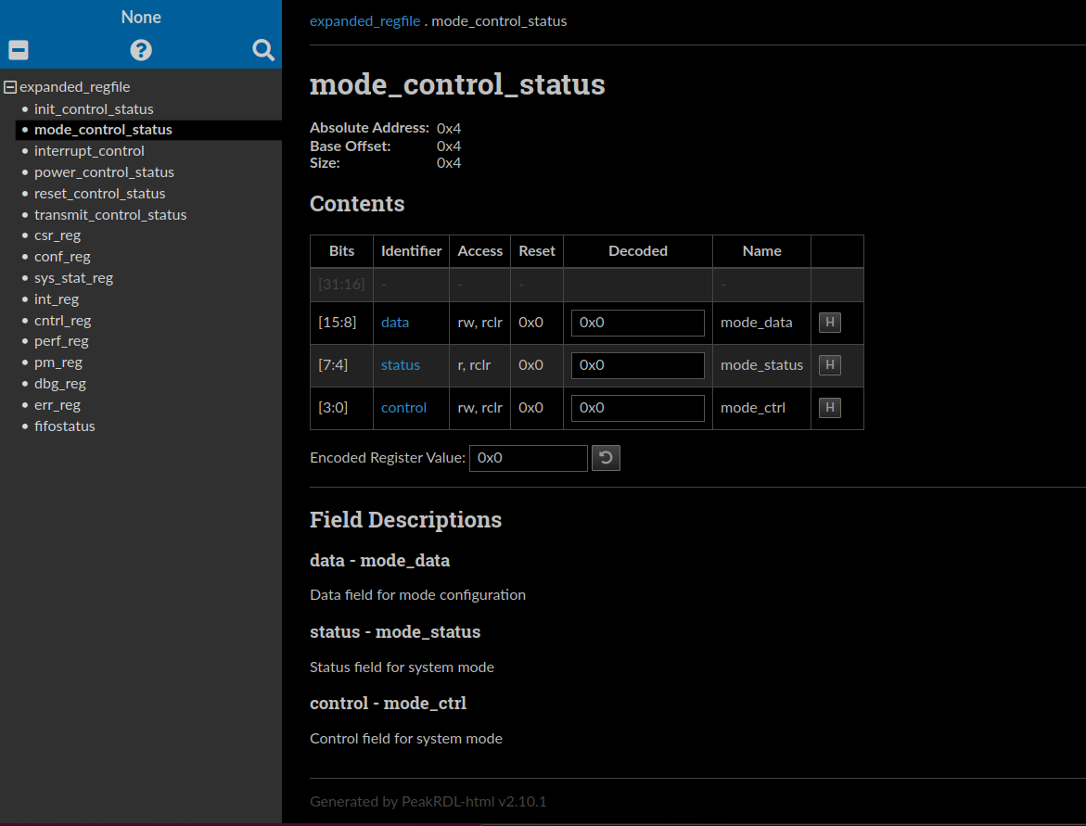
Extended Register File
Html Documentation:
  Different access types have been assigned for individual fields of register.

Slide 31
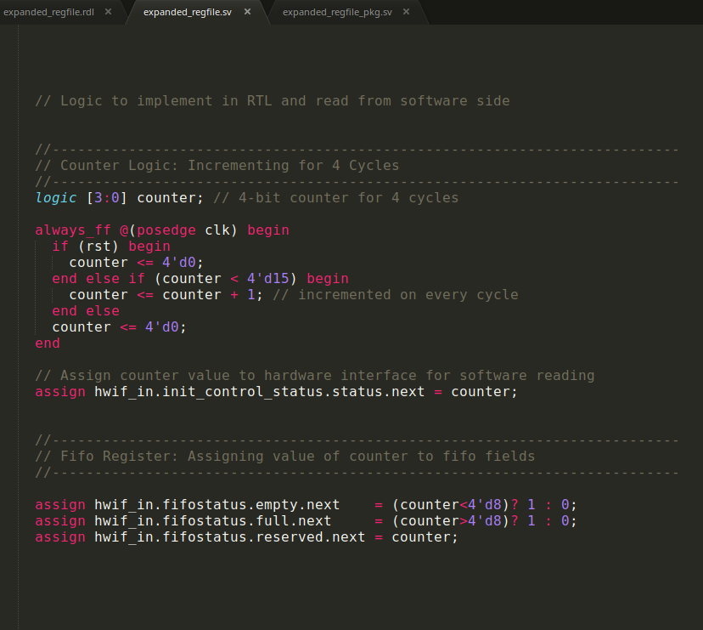
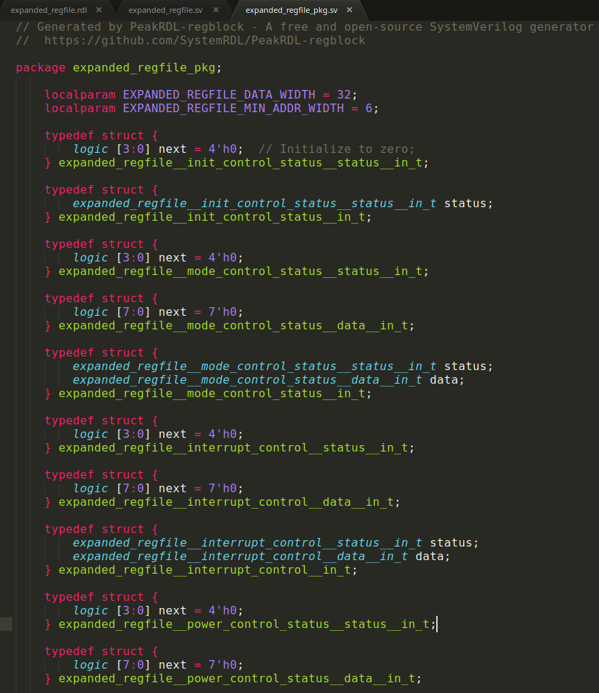
Extended Register File
Hardware write logic in RTL:
  Counter has been implemented and its value feeds in hardware access type register at every positive edge of clock.
  Initially it is appearing don’t cares (x) instead of resetting the value of hardware access types registers.
  Struct has been generated with RTL and i have initialised their values with zero.
  “Next” variable is used for hardware to write, while “Value” variable used for software to write in it.

Slide 32
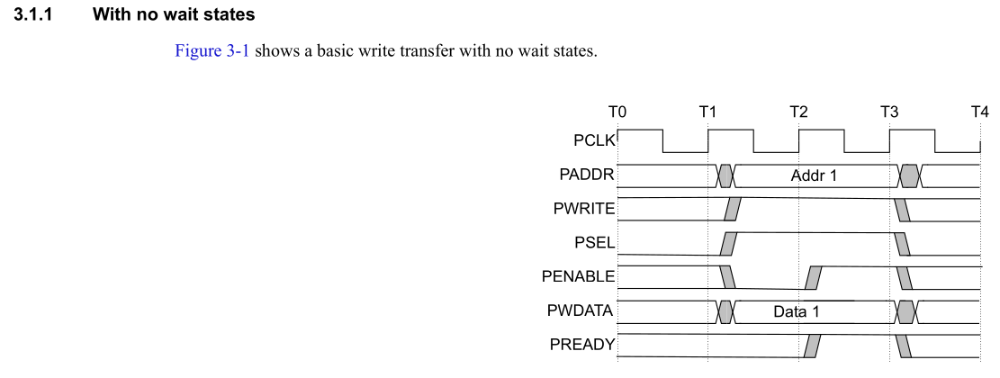
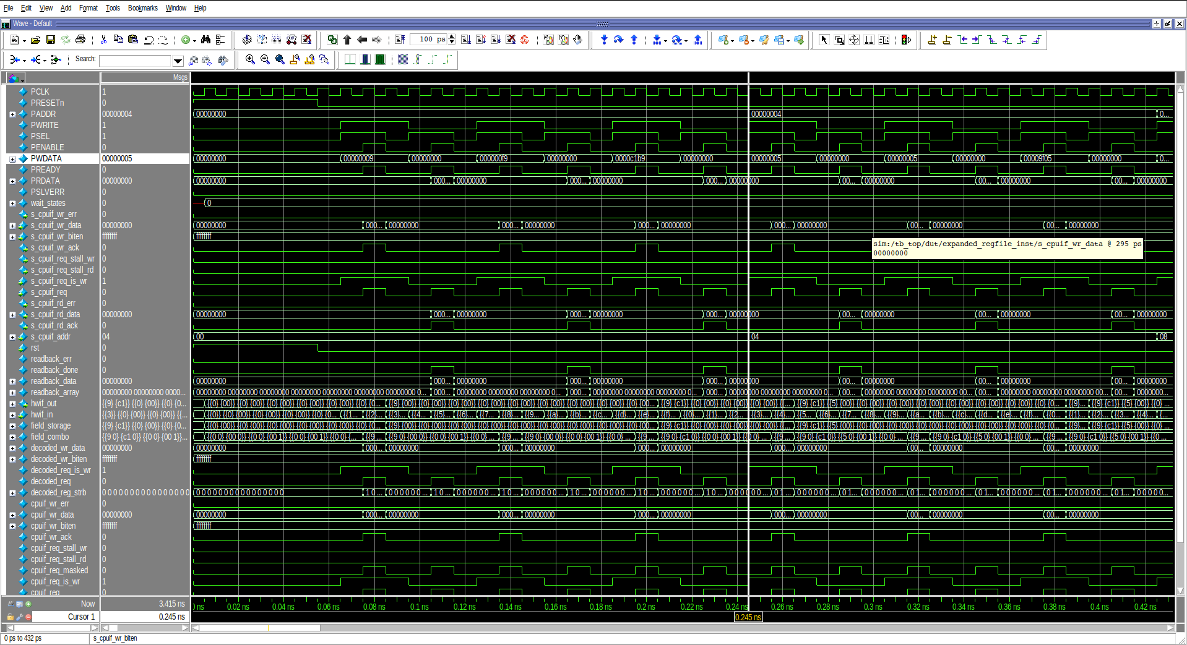
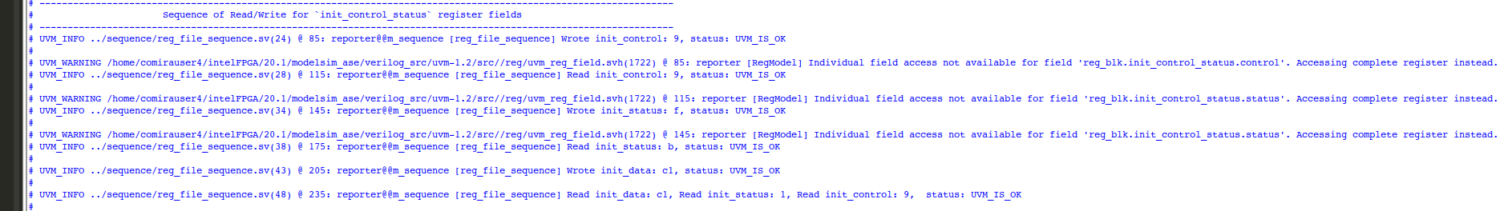
Extended Register File
Test Scenario when there is no wait state:

Slide 33
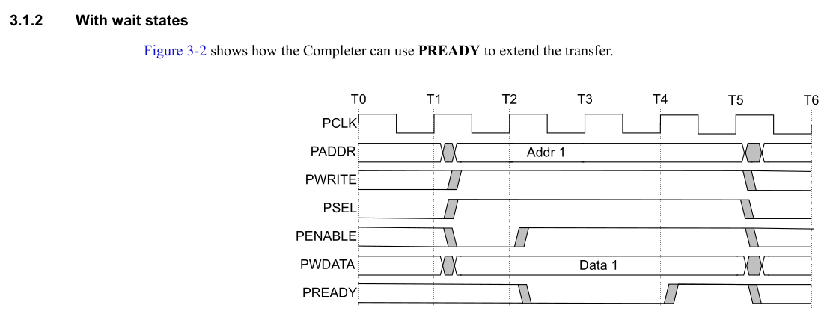
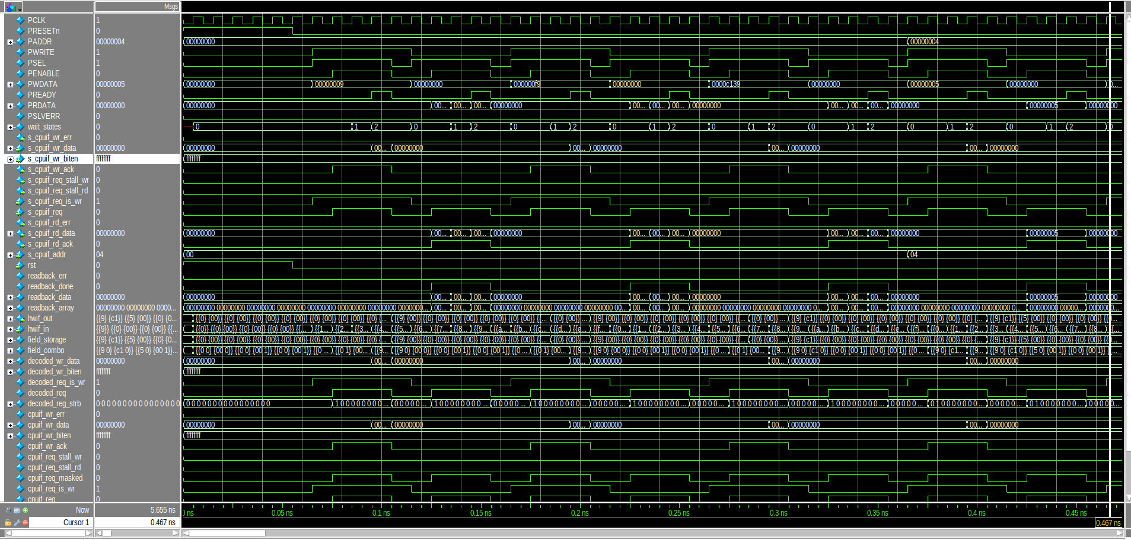
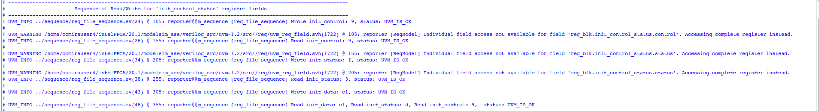
Test Scenario when there is wait state:

Slide 34
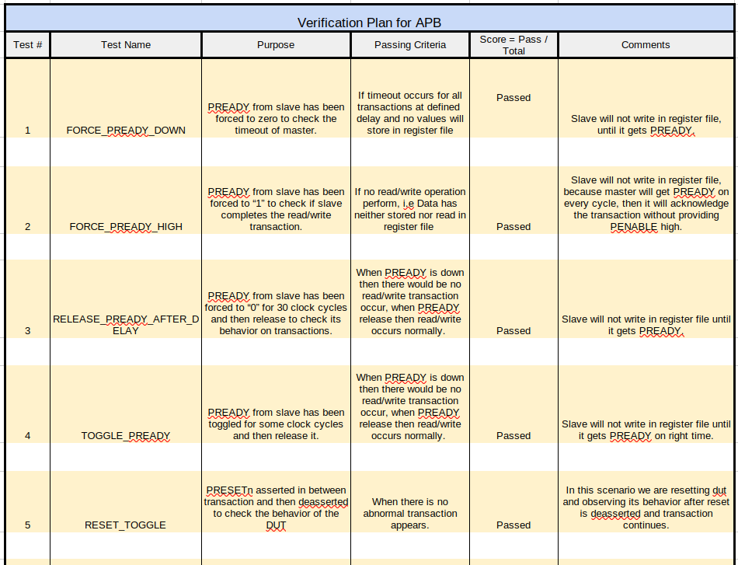
Test Plan

Slide 35
Test Plan Scenarios
FORCE_PREADY_DOWN:
  By providing +FORCE_PREADY_DOWN in run.do file.
  The timeout will occur for all transactions and it will not be successfully write/read from register file.
FORCE_PREADY_HIGH:
  By providing +FORCE_PREADY_HIGH in run.do file.
  PREADY from slave has been forced to “1” to check if slave completes the read/write transaction.
  Slave will not write in register file, because master will get PREADY on every cycle, then it will acknowledge the transaction without providing PENABLE high.
RELEASE_PREADY_AFTER_DELAY:
  By providing +RELEASE_PREADY_AFTER_DELAY in run.do file.
  PREADY from slave has been forced to “0” for 30 clock cycles and then release to check its behavior on transactions.
  When PREADY is down then there would be no read/write transaction occur, when PREADY release then read/write occurs normally.
TOGGLE_PREADY:
  By providing +TOGGLE_PREADY in run.do file.
  PREADY from slave has been toggled for some clock cycles and then release it.
  Slave will not write in register file until it gets PREADY on right time.
RESET_TOGGLE:
  By providing +RESET_TOGGLE in run.do file.
  PRESETn asserted in between transaction and then deasserted to check the behavior of the DUT
  In this scenario we are resetting dut and observing its behavior after reset is deasserted and transaction continues.

Slide 36
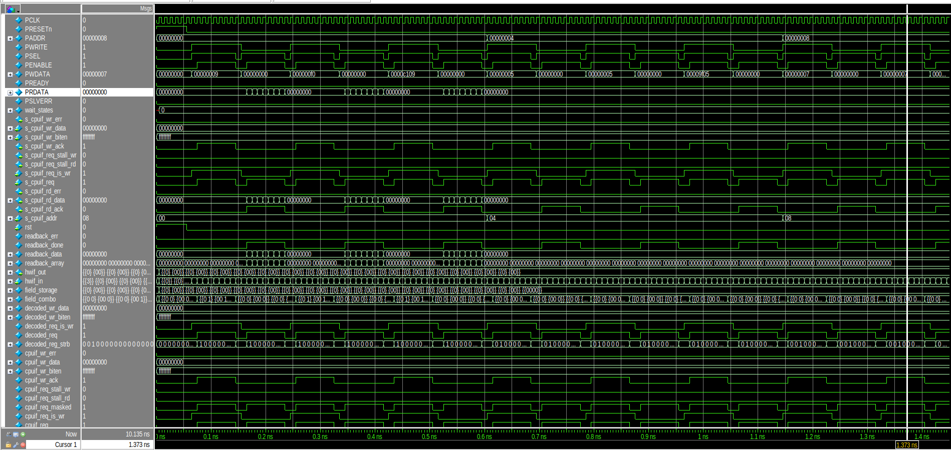
FORCE_PREADY_DOWN Waveform

Slide 37
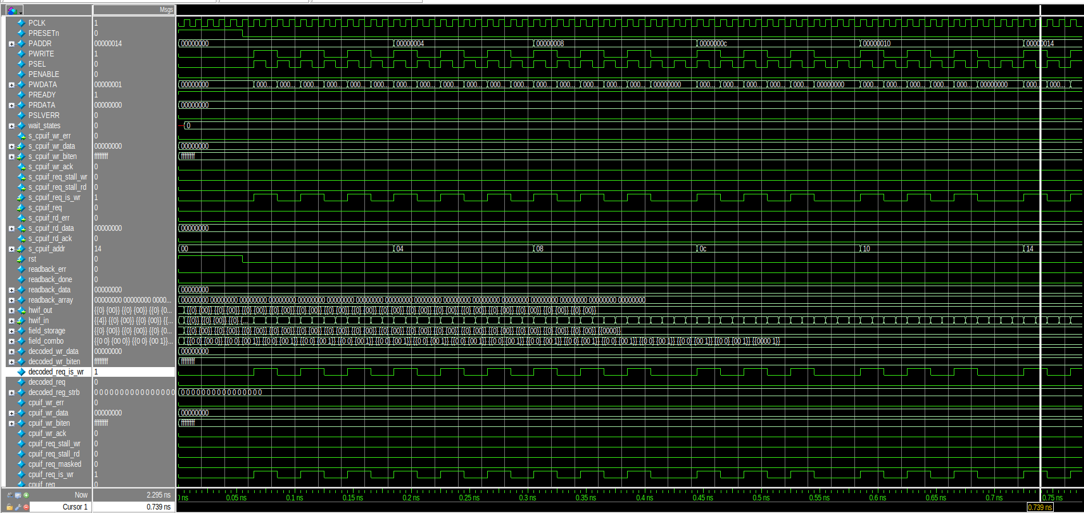
FORCE_PREADY_HIGH Waveform

Slide 38
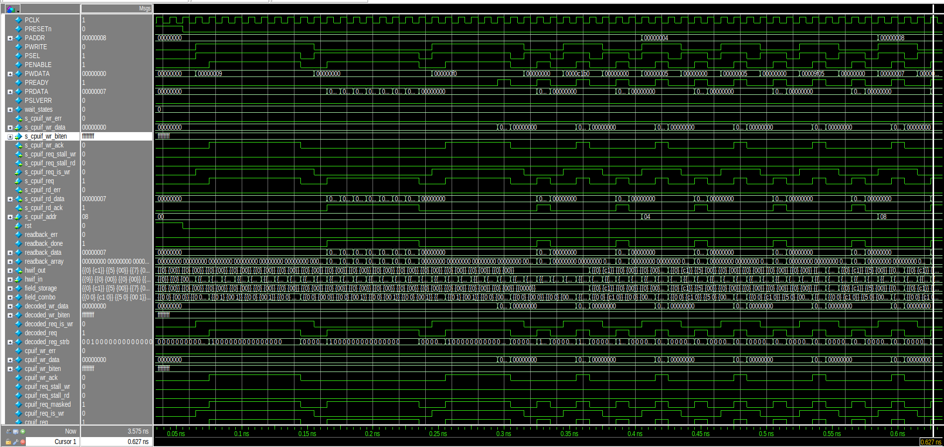
RELEASE_PREADY_AFTER_DELAY Waveform

Slide 39
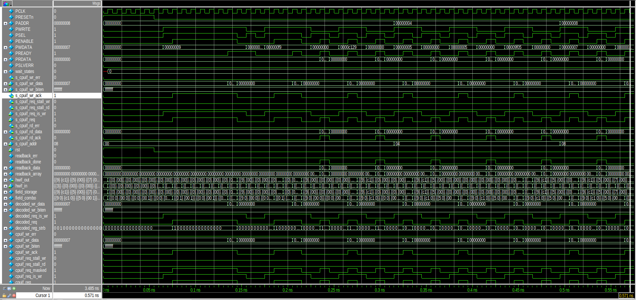
TOGGLE_PREADY Waveform

Slide 40
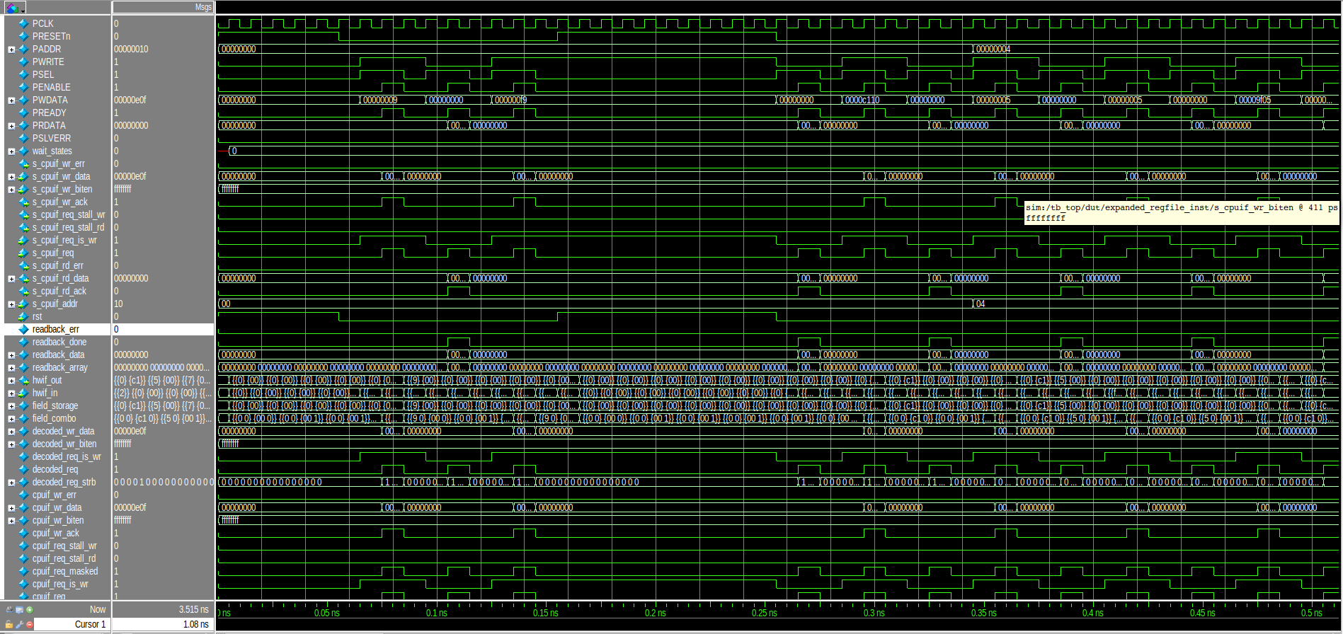
RESET_TOGGLE Waveform

Slide 41
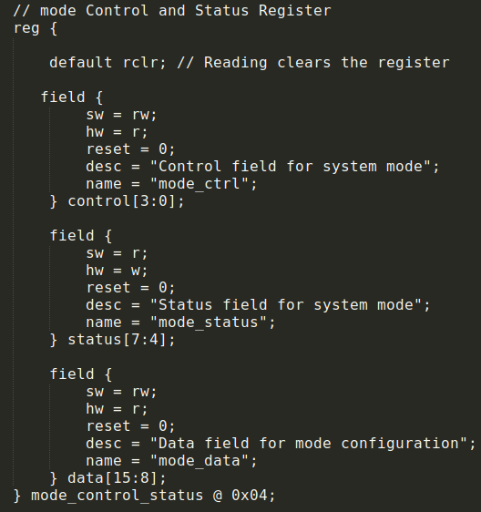
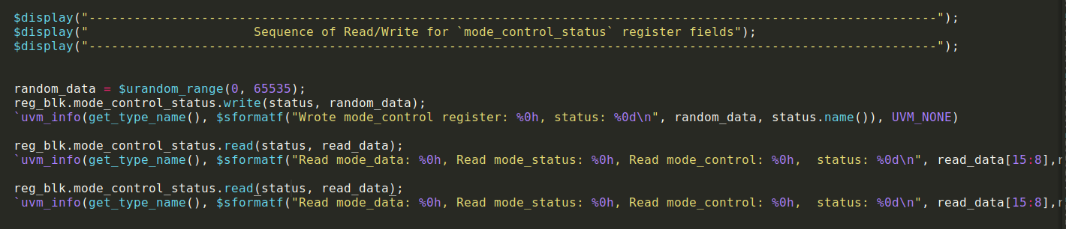
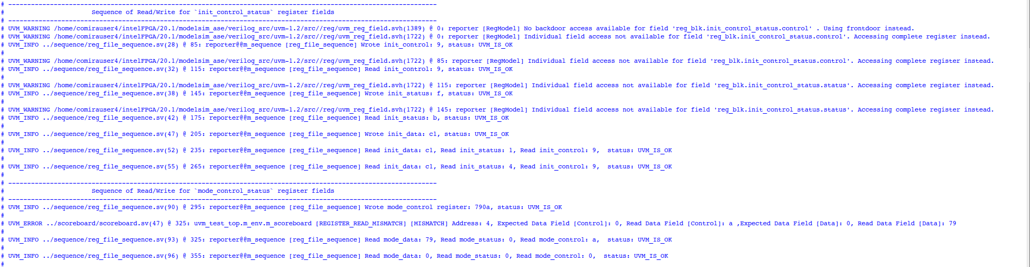
Clear on Read (rclr) Implementation

Slide 42


Slide 43


Slide 44
References
ChipVerify
https://www.chipverify.com/uvm/uvm-register-model-example
APB Spec
https://documentation-service.arm.com/static/60d5b505677cf7536a55c245?token=
PeakRDL
https://peakrdl.readthedocs.io/en/latest/
SystemRDL Spec
https://www.accellera.org/images/downloads/standards/systemrdl/SystemRDL_2.0_Jan2018.pdf
Github
https://github.com/SystemRDL
Youtube
https://www.youtube.com/watch?v=R8RBlF63aL8
Agnisys
https://www.agnisys.com/blog/efficient-hardware-description-transforming-systemrdl-into-multiple-formats-for-seamless-integration/

